Slide 1


Slide 2
POW MIA MUSEUM JACKSONVILLE FLORIDA

Slide 3
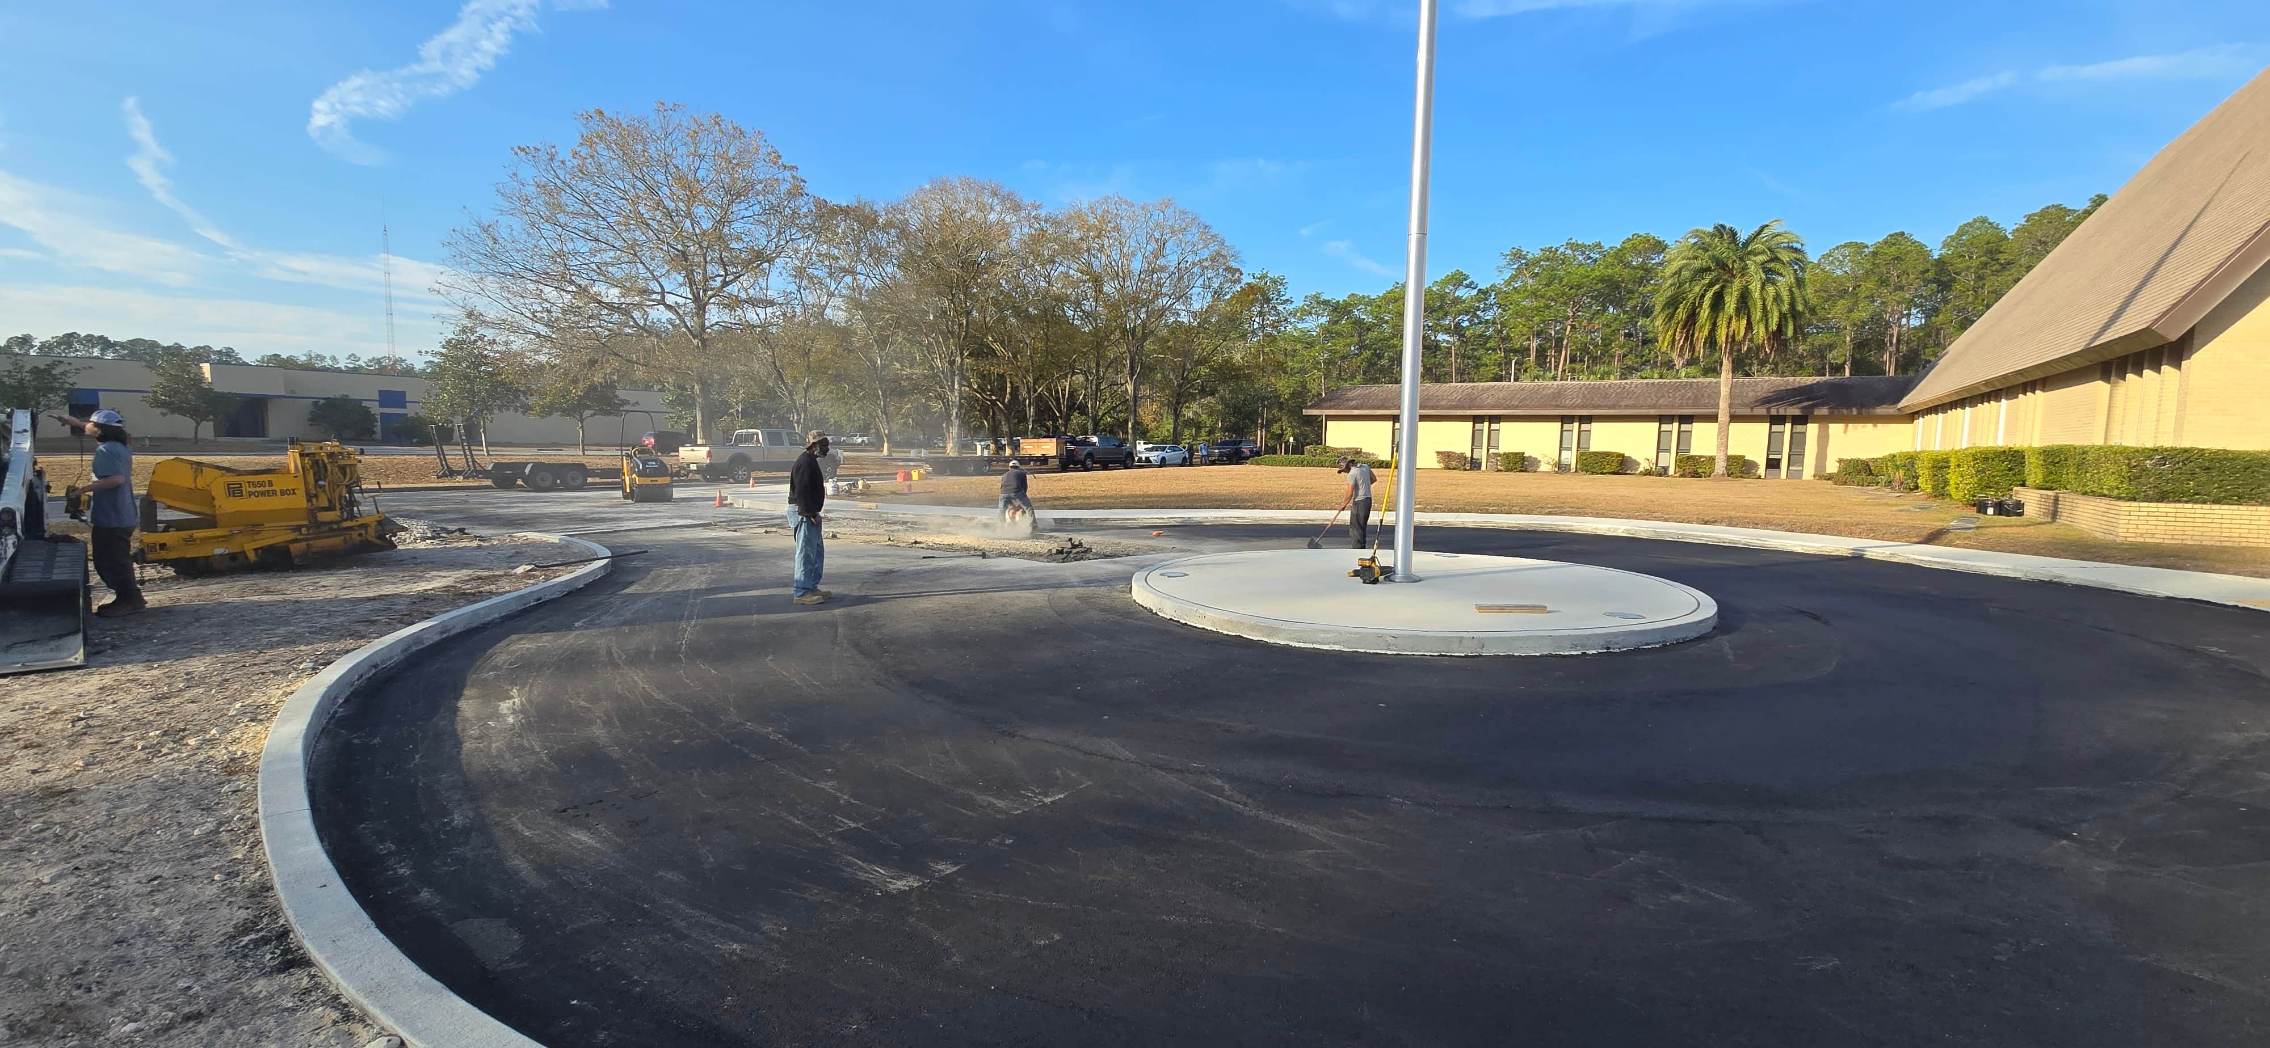
POW MIA MUSEUM JACKSONVILLE FLORIDA

Slide 4
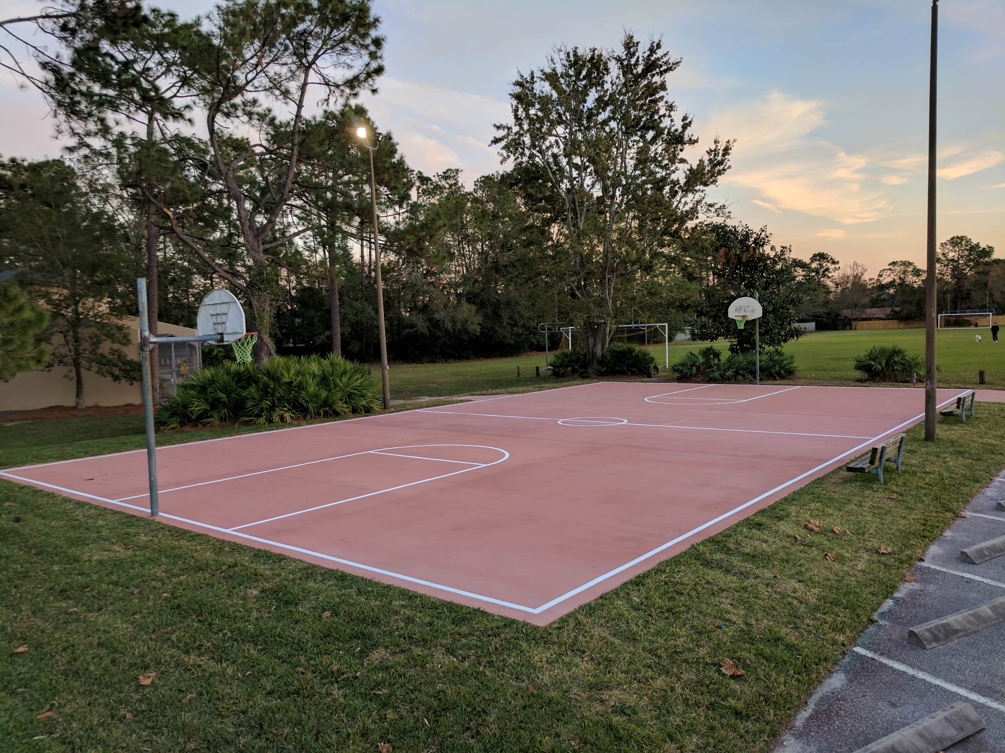
“The Woods” Sub Basketball Ct. JACKSONVILLE FLORIDA

Slide 5
“CIRCLE DRIVE W/ STAMP BRICK BOARDER”
JACKSONVILLE FLORIDA

Slide 6
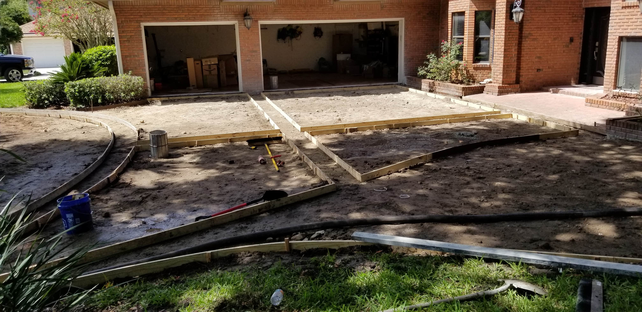
“CIRCLE DRIVE W/ STAMP BRICK BOARDER”
JACKSONVILLE FLORIDA

Slide 7
“CIRCLE DRIVE W/ STAMP BRICK BOARDER”
JACKSONVILLE FLORIDA

Slide 8
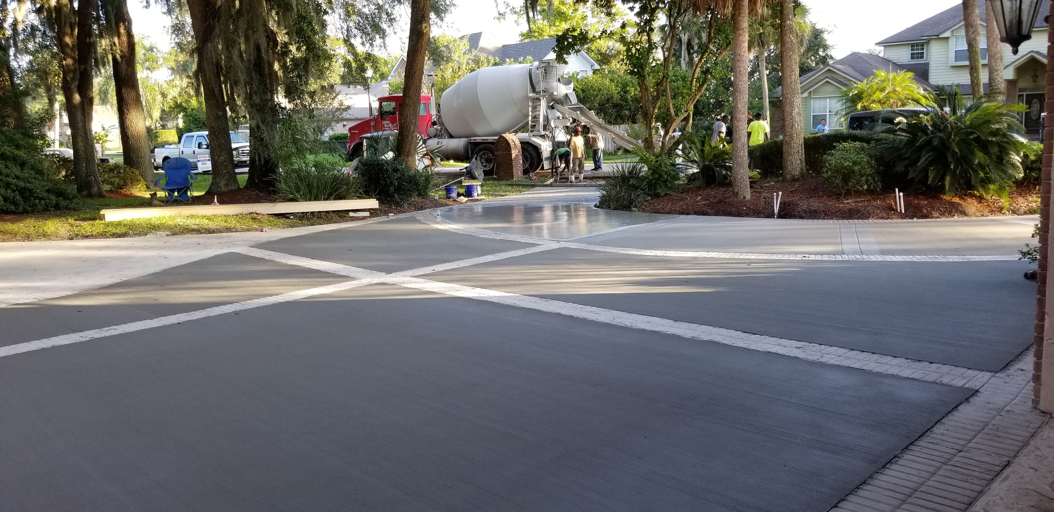
“CIRCLE DRIVE W/ STAMP BRICK BOARDER”
JACKSONVILLE FLORIDA

Slide 9
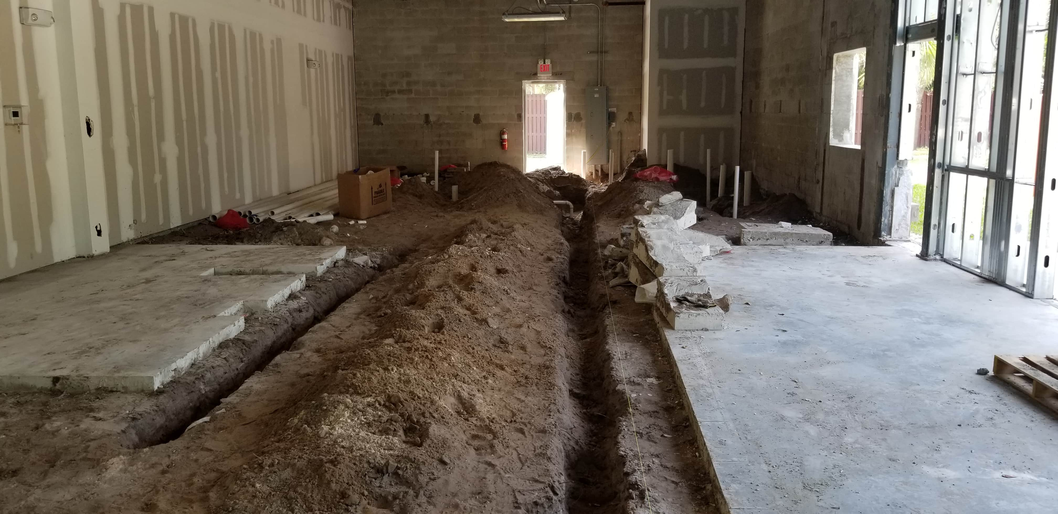
“BANTAM & BIDDY RESTAURANT AMELIA ISLAND”
JACKSONVILLE FLORIDA

Slide 10
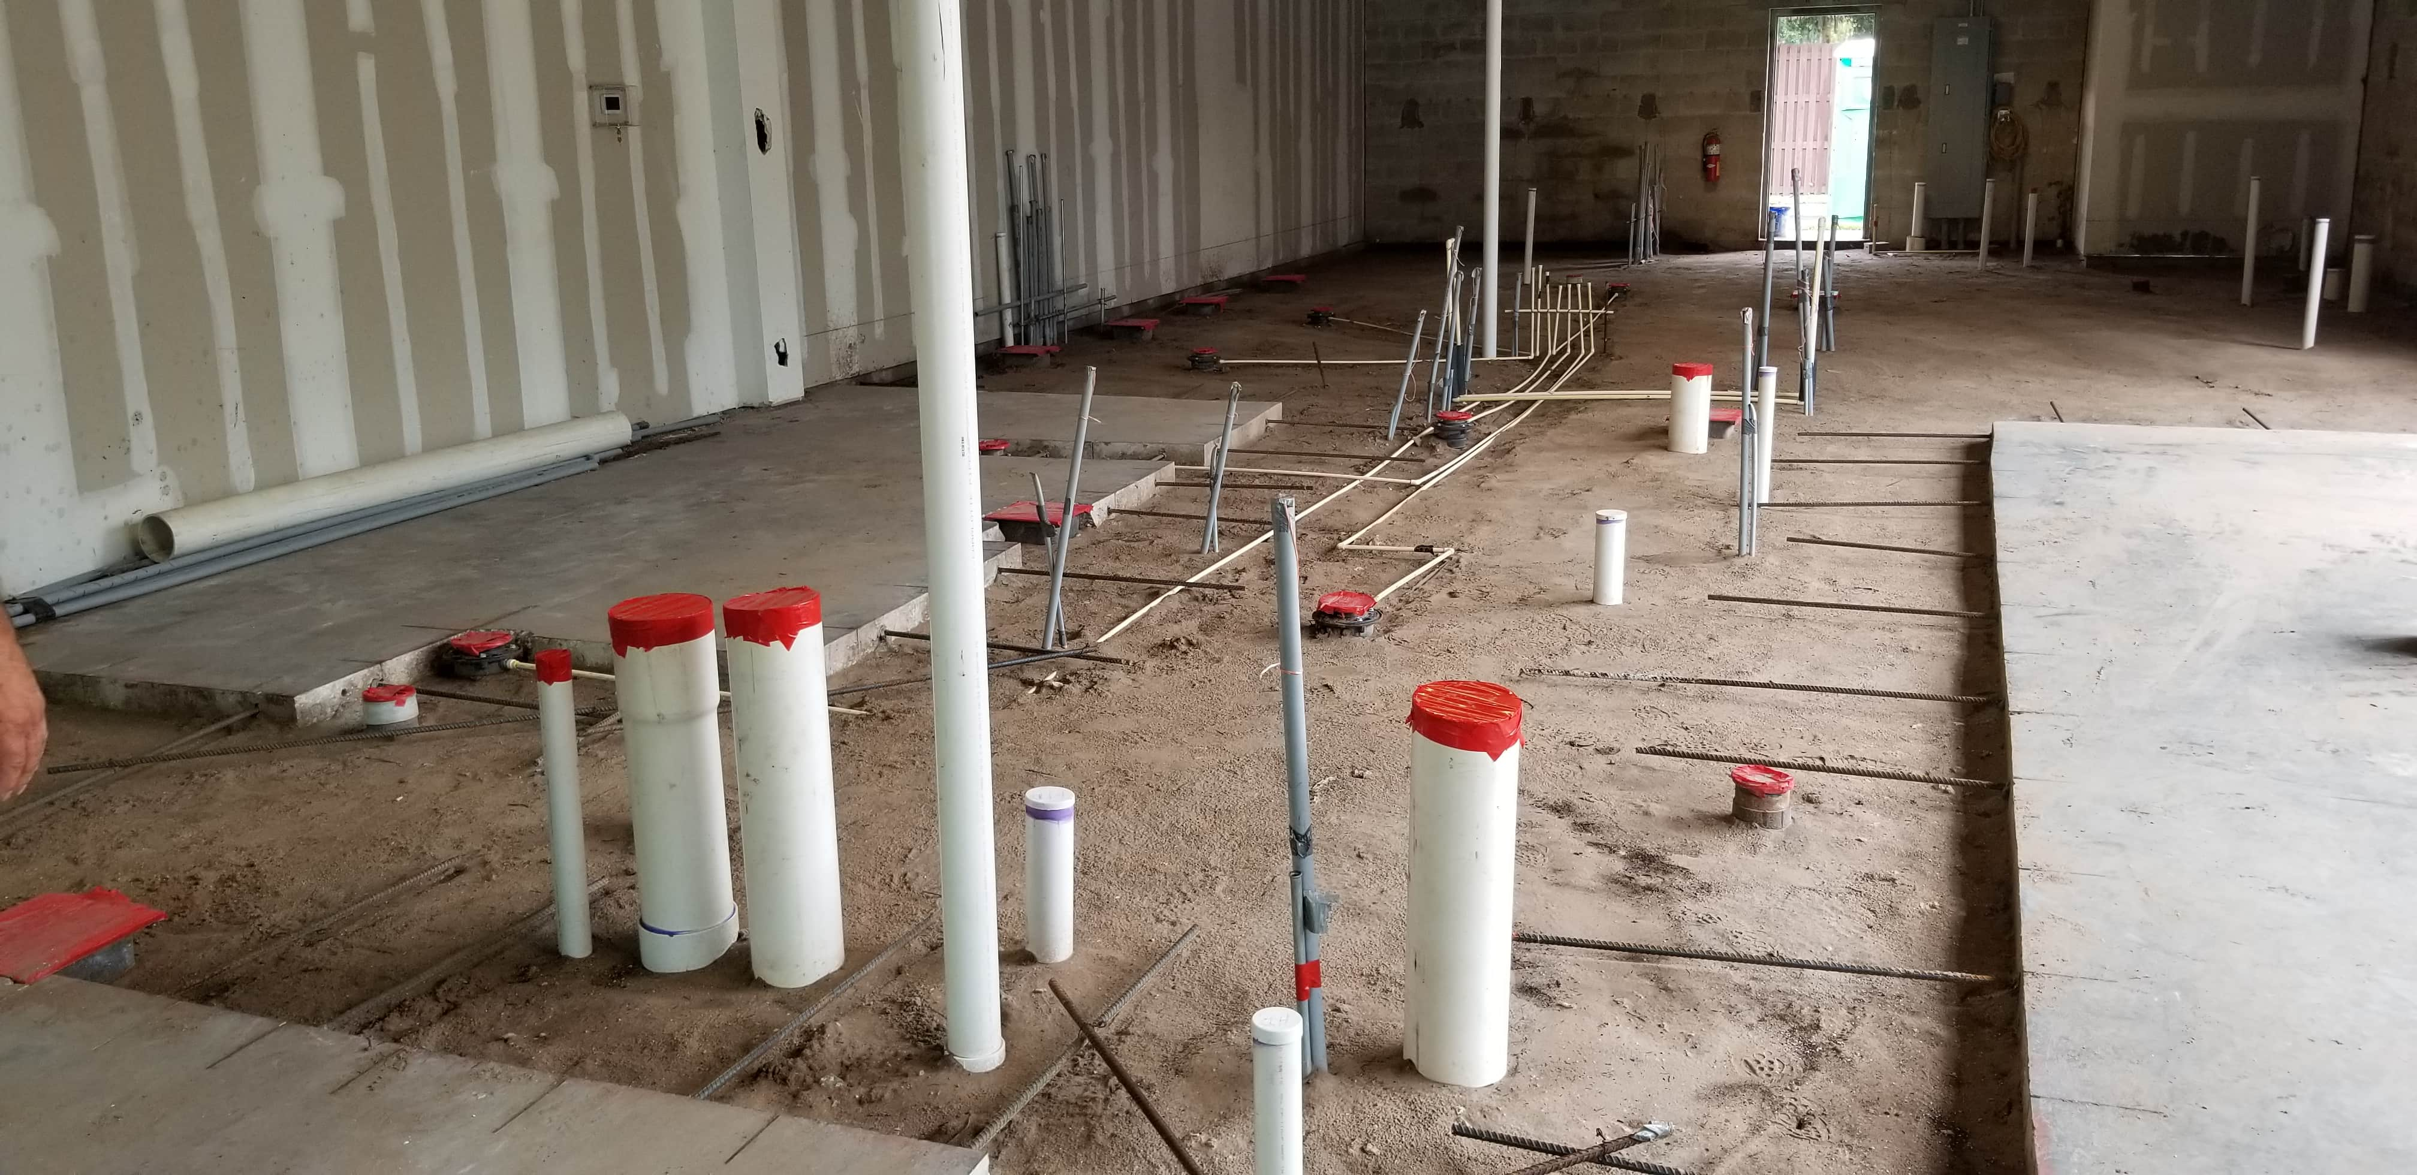
“BANTAM & BIDDY RESTAURANT AMELIA ISLAND”
JACKSONVILLE FLORIDA

Slide 11
“BANTAM & BIDDY RESTAURANT AMELIA ISLAND”
JACKSONVILLE FLORIDA

Slide 12
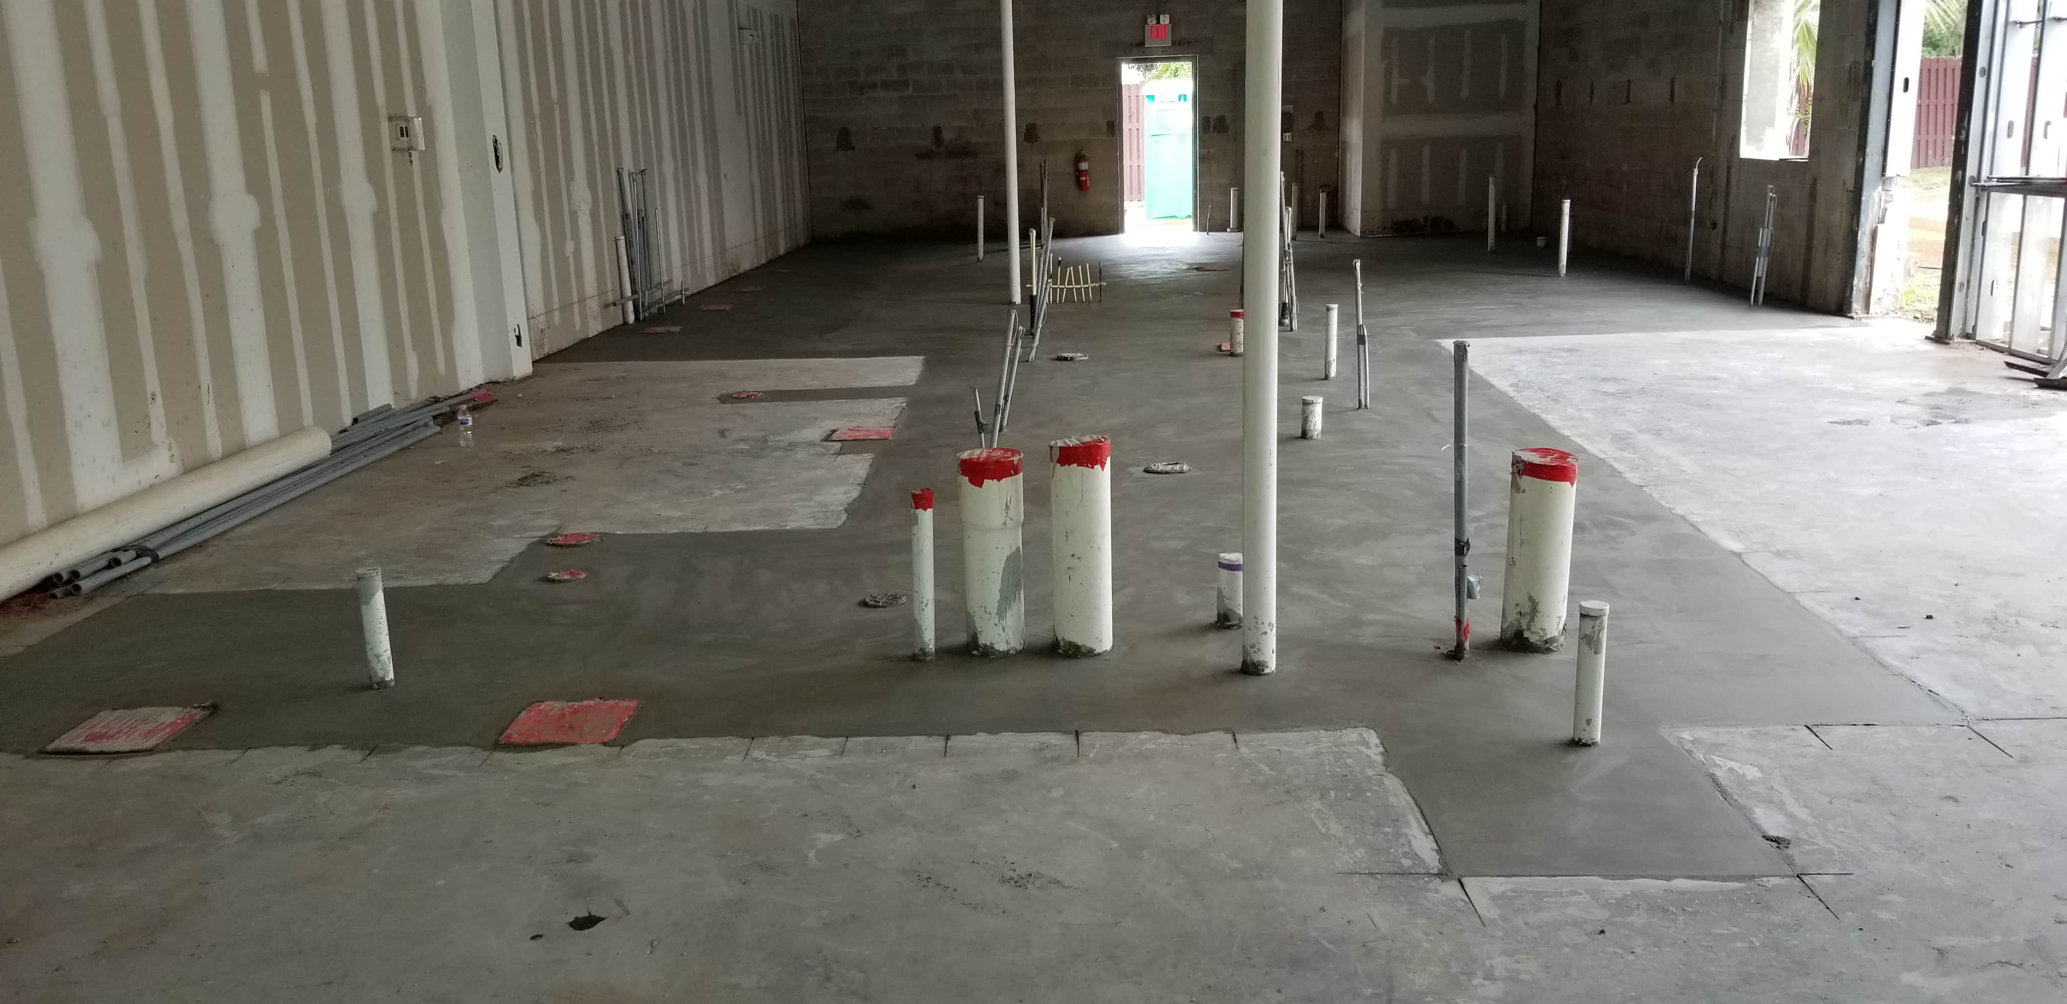
“BANTAM & BIDDY RESTAURANT AMELIA ISLAND”
JACKSONVILLE FLORIDA

Slide 13
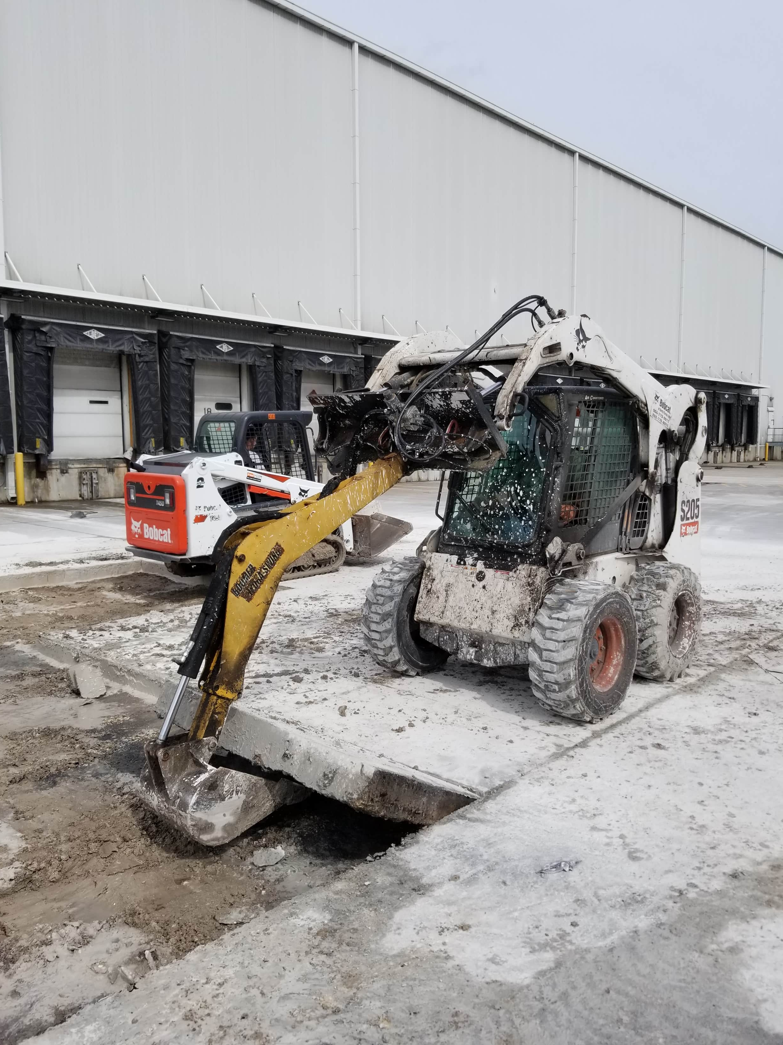
“BURRIS / LINEAGE REFRIDGERATION PARKING LOT ”
JACKSONVILLE FLORIDA

Slide 14
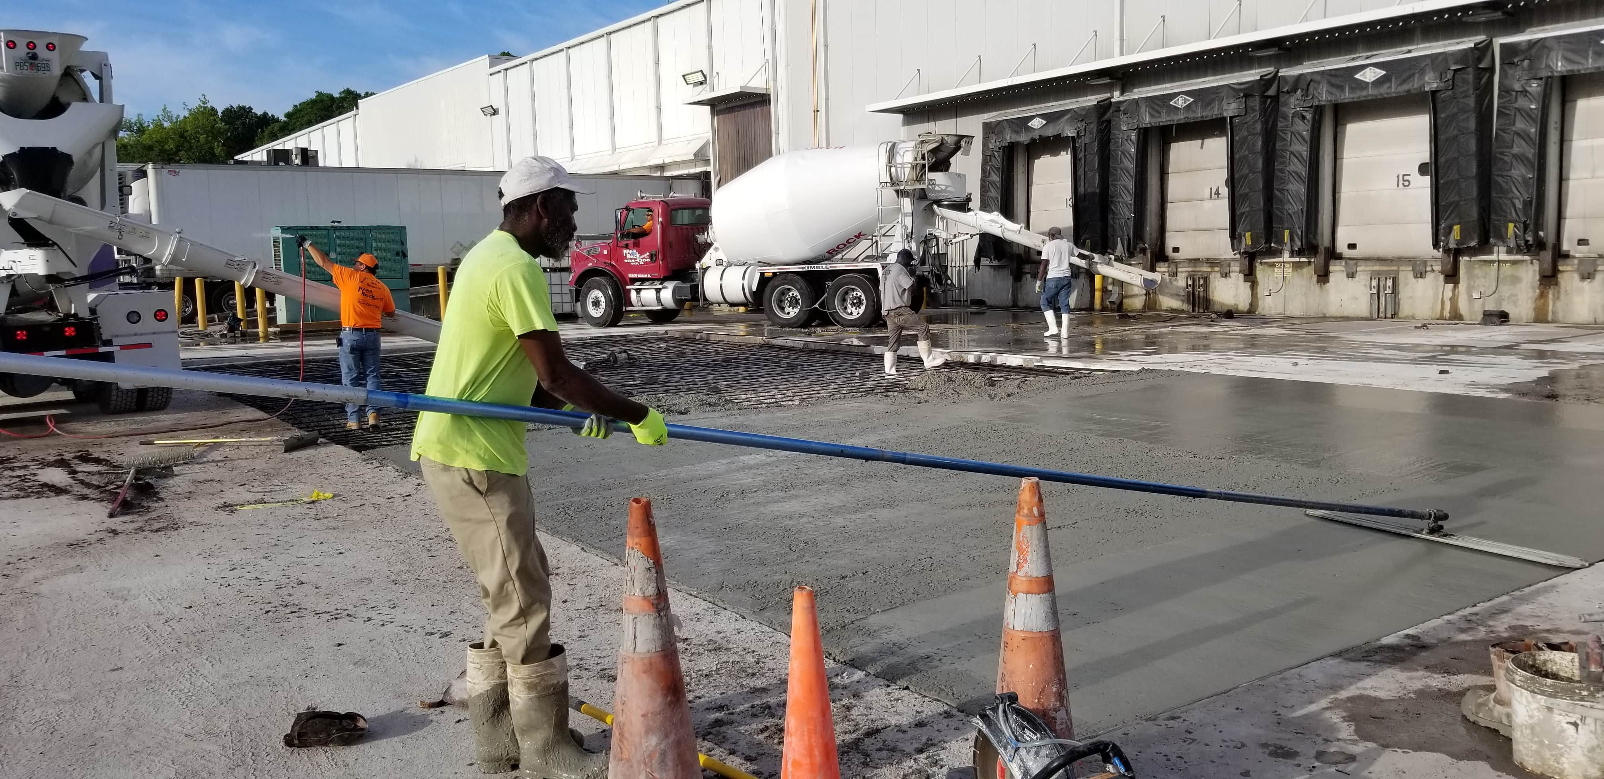
“BURRIS / LINEAGE REFRIDGERATION PARKING LOT ”
JACKSONVILLE FLORIDA

Slide 15
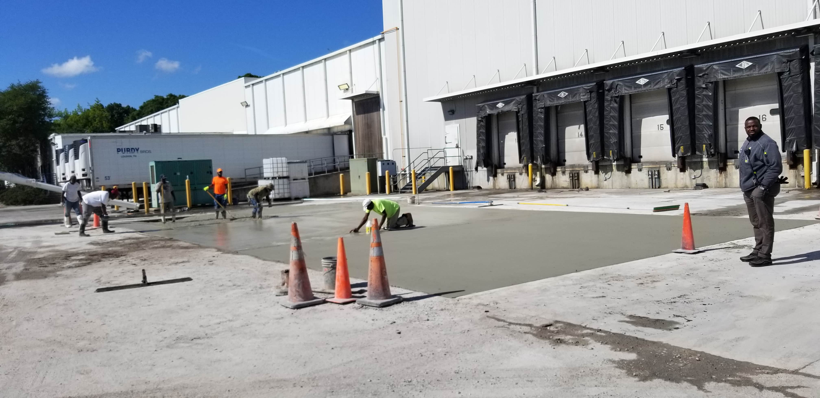
“BURRIS / LINEAGE REFRIDGERATION PARKING LOT ”
JACKSONVILLE FLORIDA

Slide 16
“CSX ENTRANCE ASPHALT PAVING PROJECT ”
JACKSONVILLE FLORIDA

Slide 17
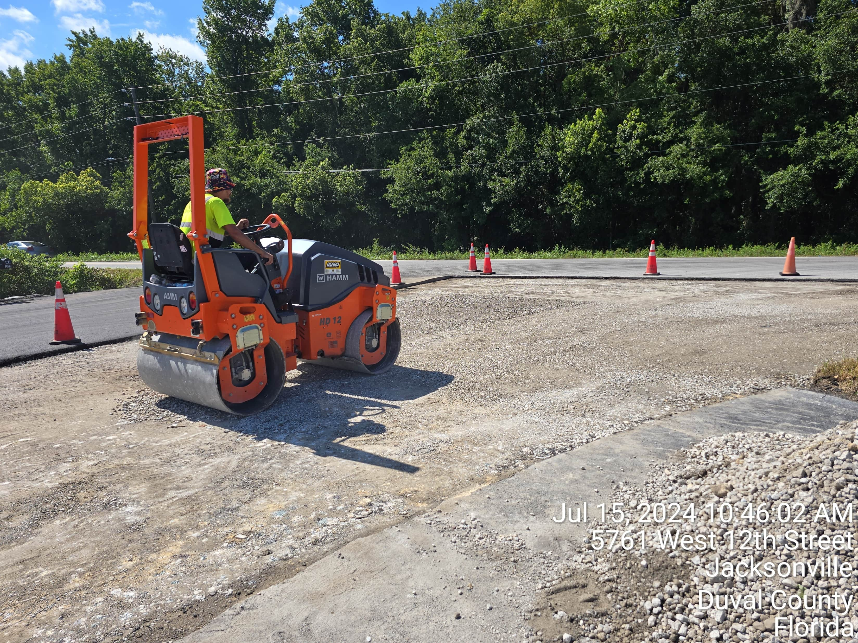
“CSX ENTRANCE ASPHALT PAVING PROJECT ”
JACKSONVILLE FLORIDA

Slide 18
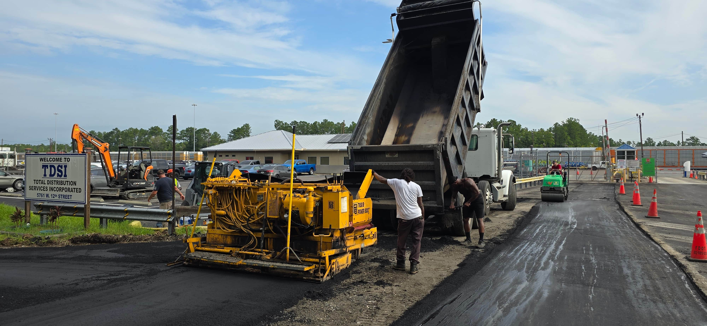
“CSX ENTRANCE ASPHALT PAVING PROJECT ”
JACKSONVILLE FLORIDA

Slide 19
“CSX ENTRANCE ASPHALT PAVING PROJECT ”
JACKSONVILLE FLORIDA

Slide 20
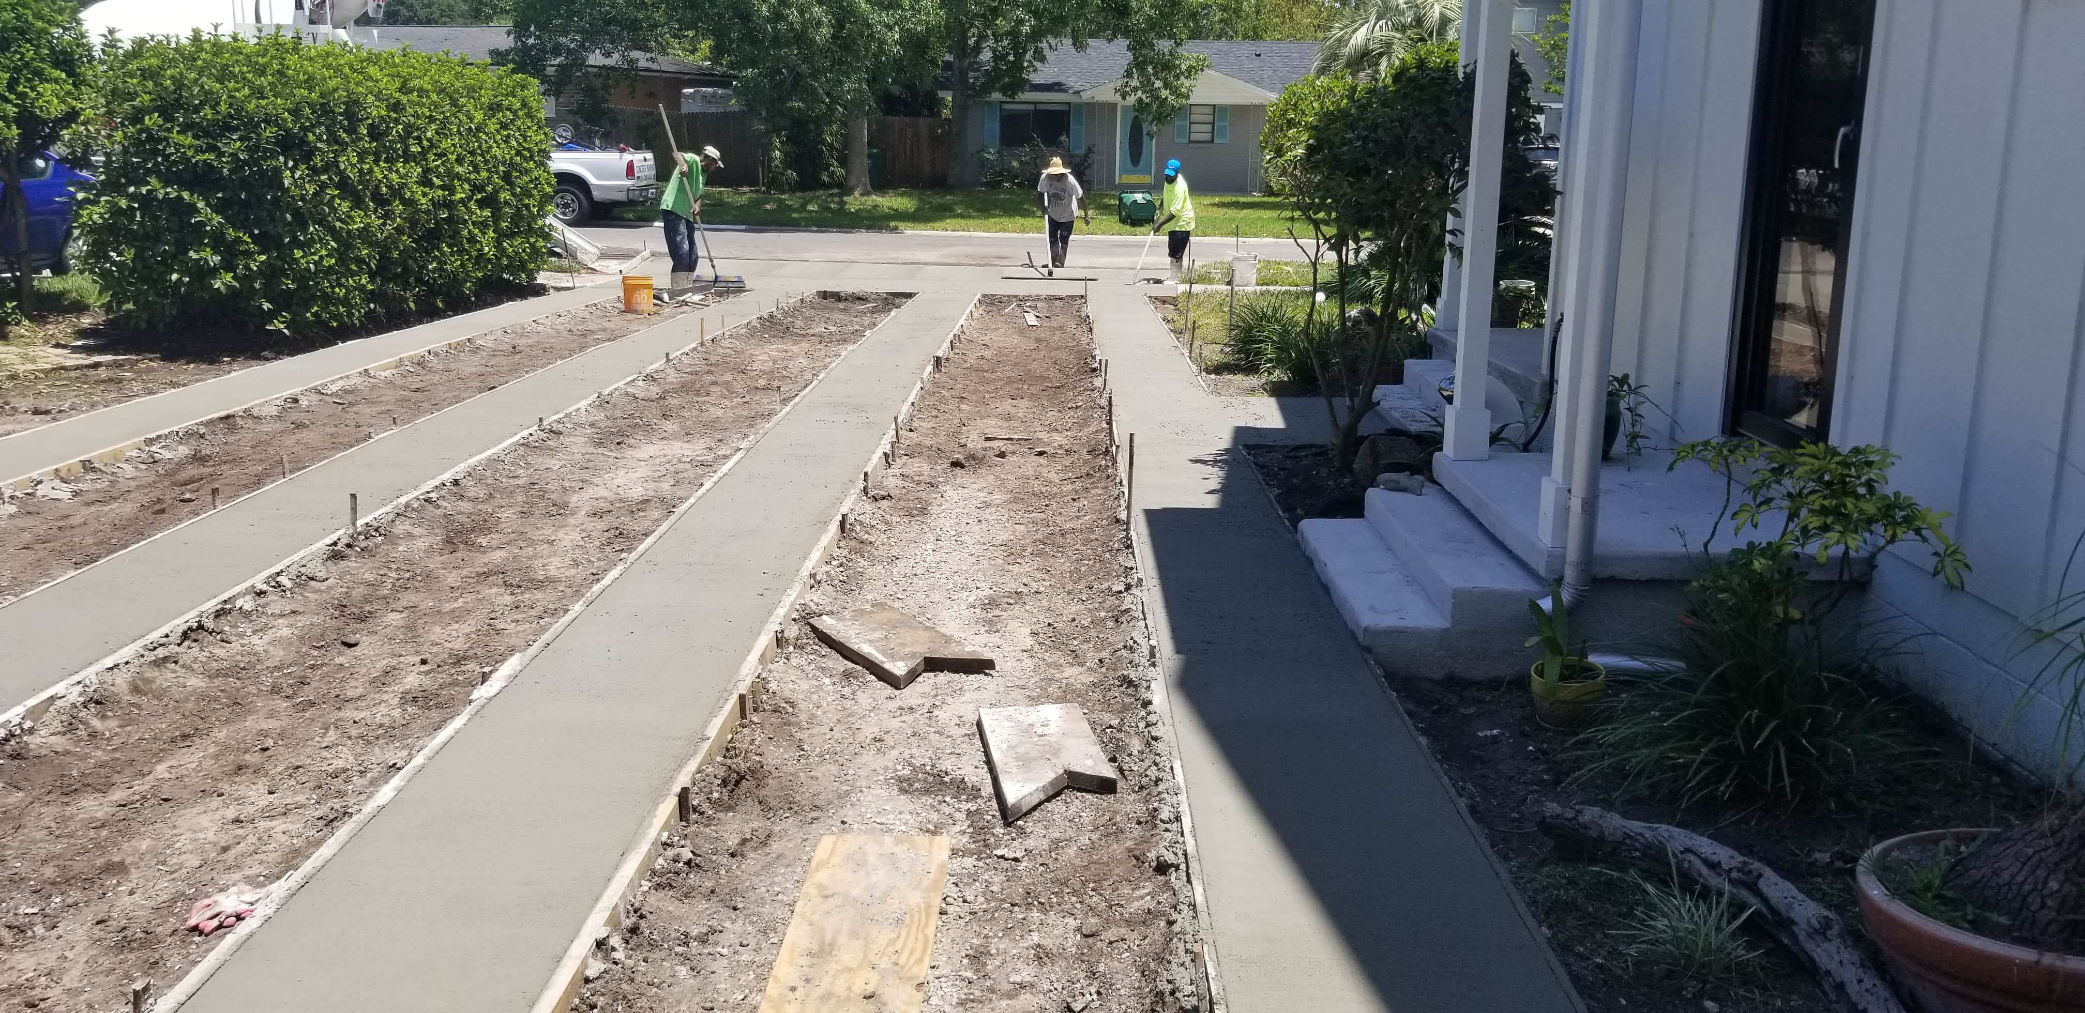
“DOUBLE STRIP DRIVEWAYS JAX BEACH ”
JACKSONVILLE FLORIDA

Slide 21
“DOUBLE STRIP DRIVEWAYS JAX BEACH ”
JACKSONVILLE FLORIDA

Slide 22
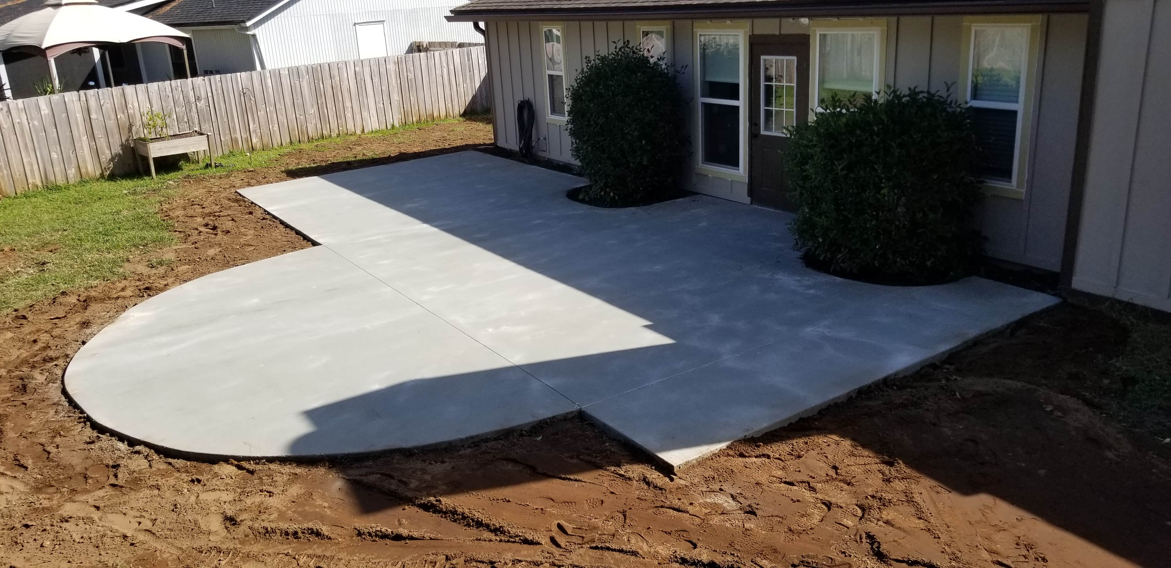
“ROUNDED PATIO MANDARIN FL”
JACKSONVILLE FLORIDA

Slide 23
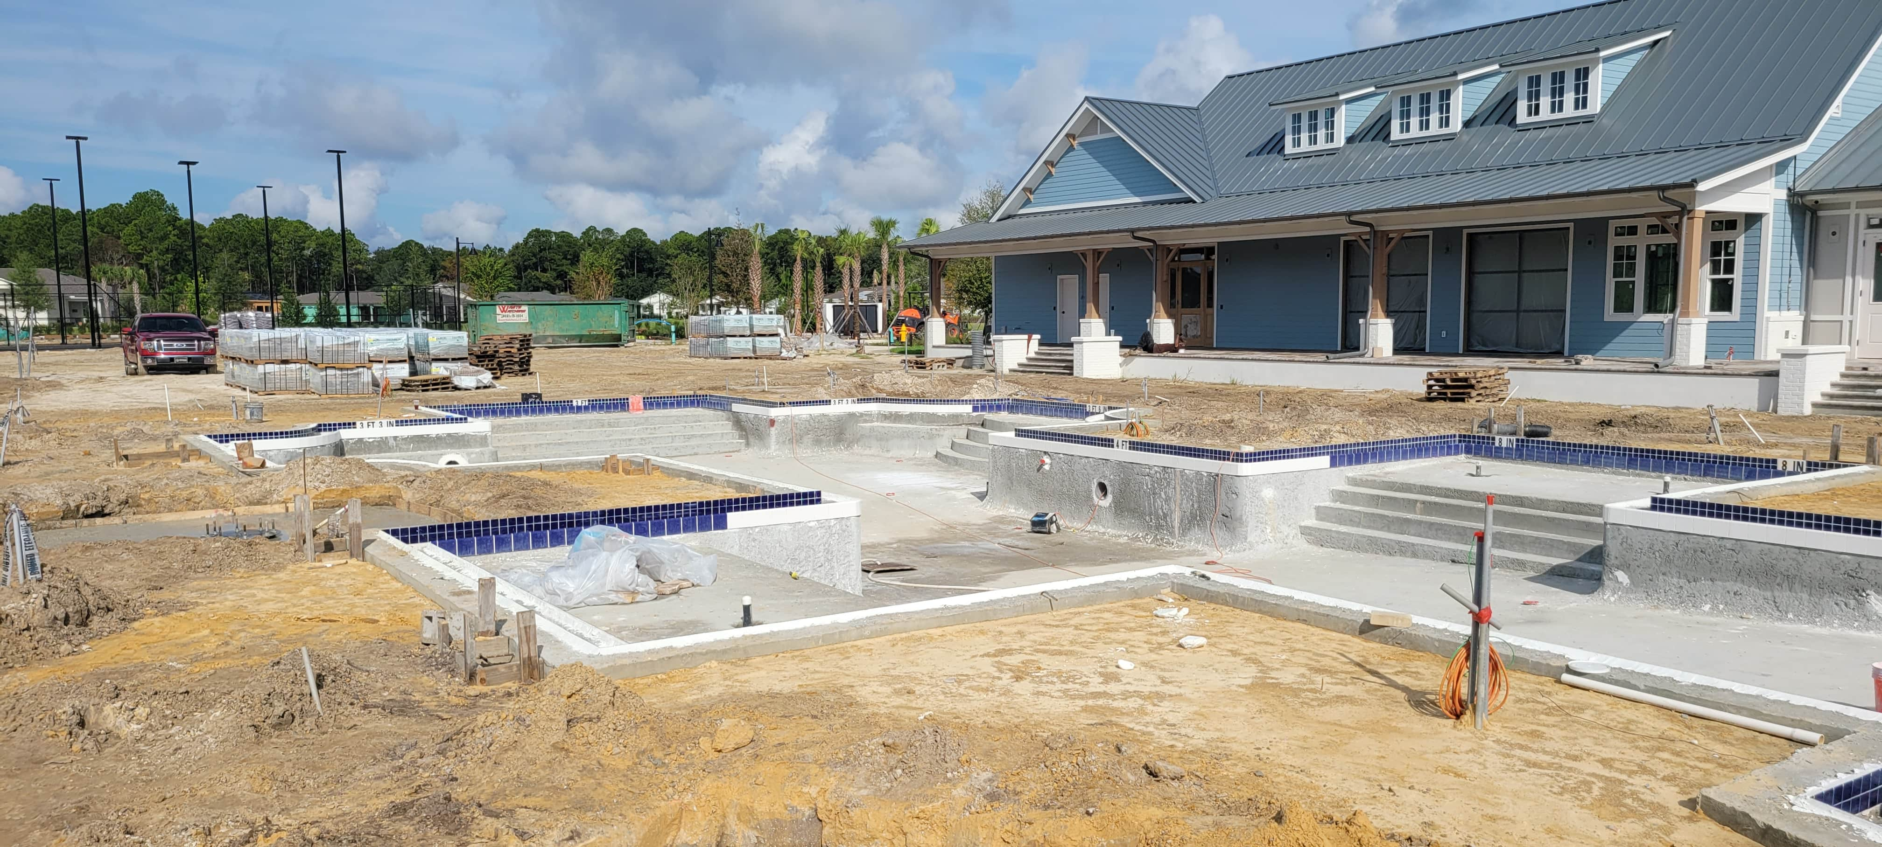
“SILVERLEAF CLUB HOUSE POOL & PAVILION”
JACKSONVILLE FLORIDA

Slide 24
“SILVERLEAF CLUB HOUSE POOL & PAVILION”
JACKSONVILLE FLORIDA

Slide 25
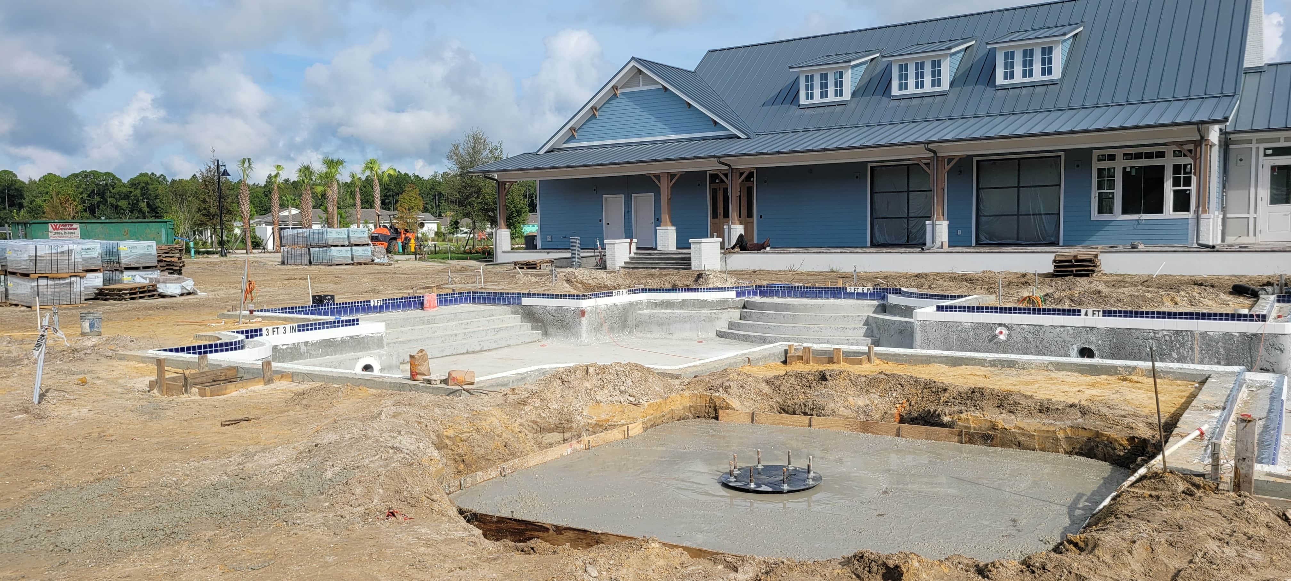
“SILVERLEAF CLUB HOUSE POOL & PAVILION”
JACKSONVILLE FLORIDA

Slide 26
“ASPHALT REPAIRS CSX RAIL YARD”
JACKSONVILLE FLORIDA

Slide 27
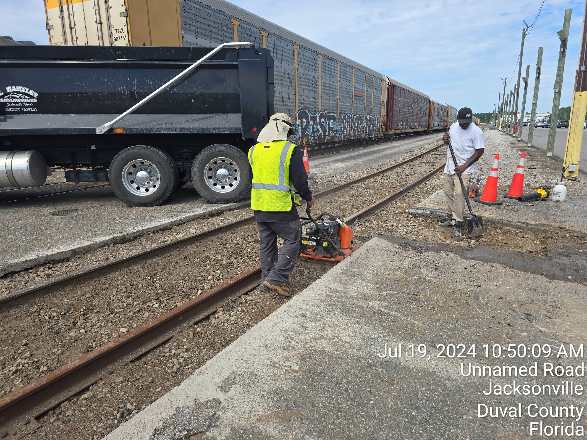
“ASPHALT REPAIRS CSX RAIL YARD”
JACKSONVILLE FLORIDA

Slide 28
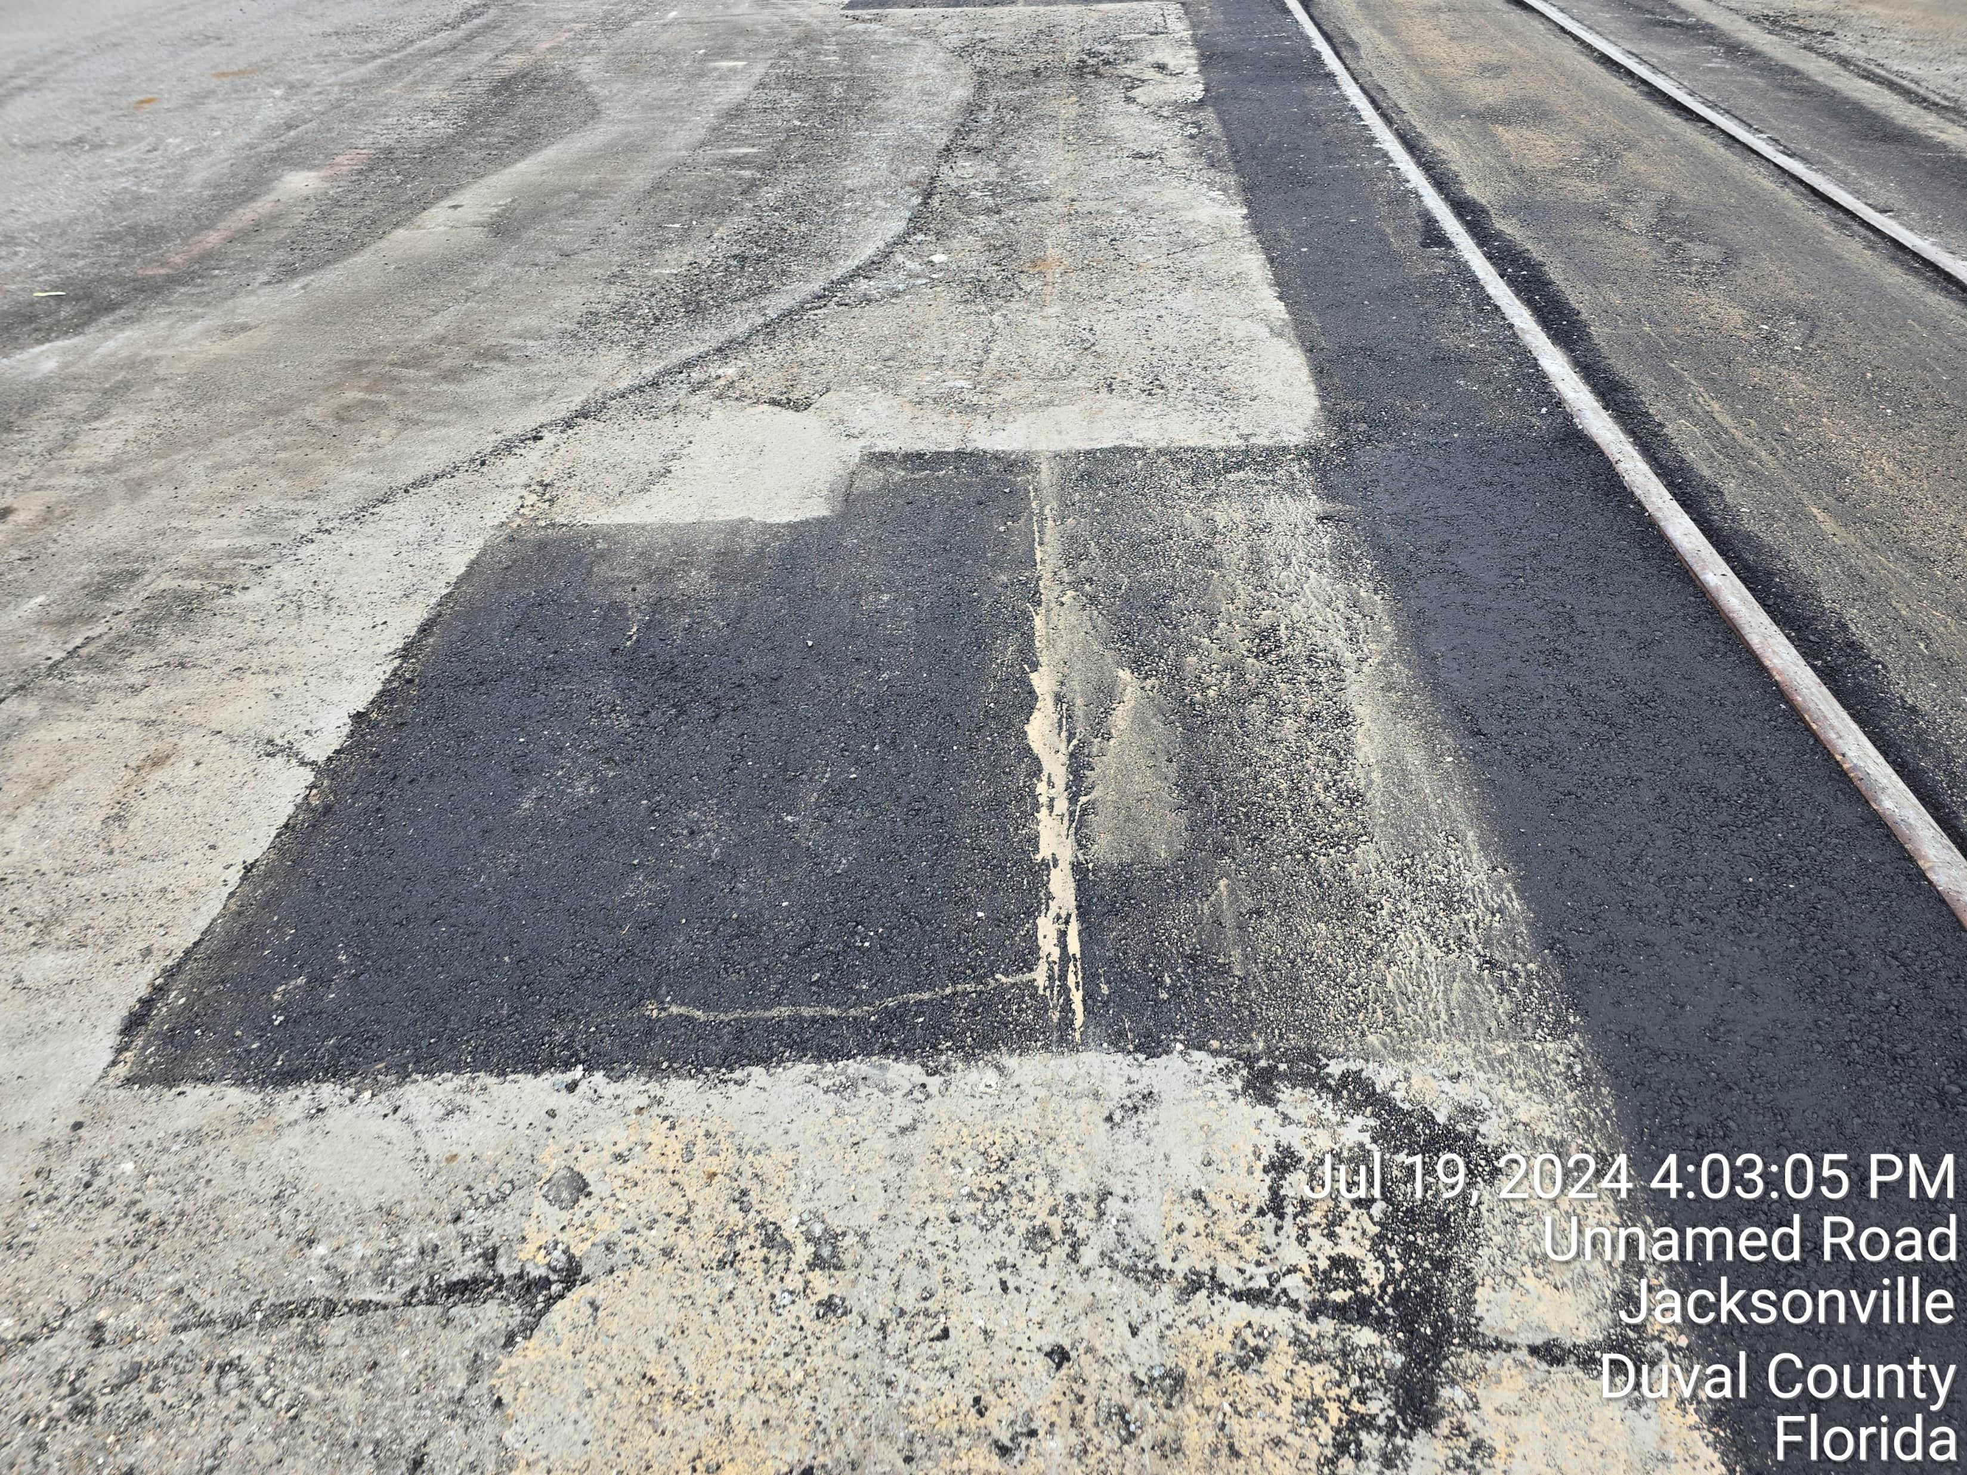
“ASPHALT REPAIRS CSX RAIL YARD”
JACKSONVILLE FLORIDA

Slide 29
“ASPHALT REPAIRS CSX RAIL YARD”
JACKSONVILLE FLORIDA

Slide 30
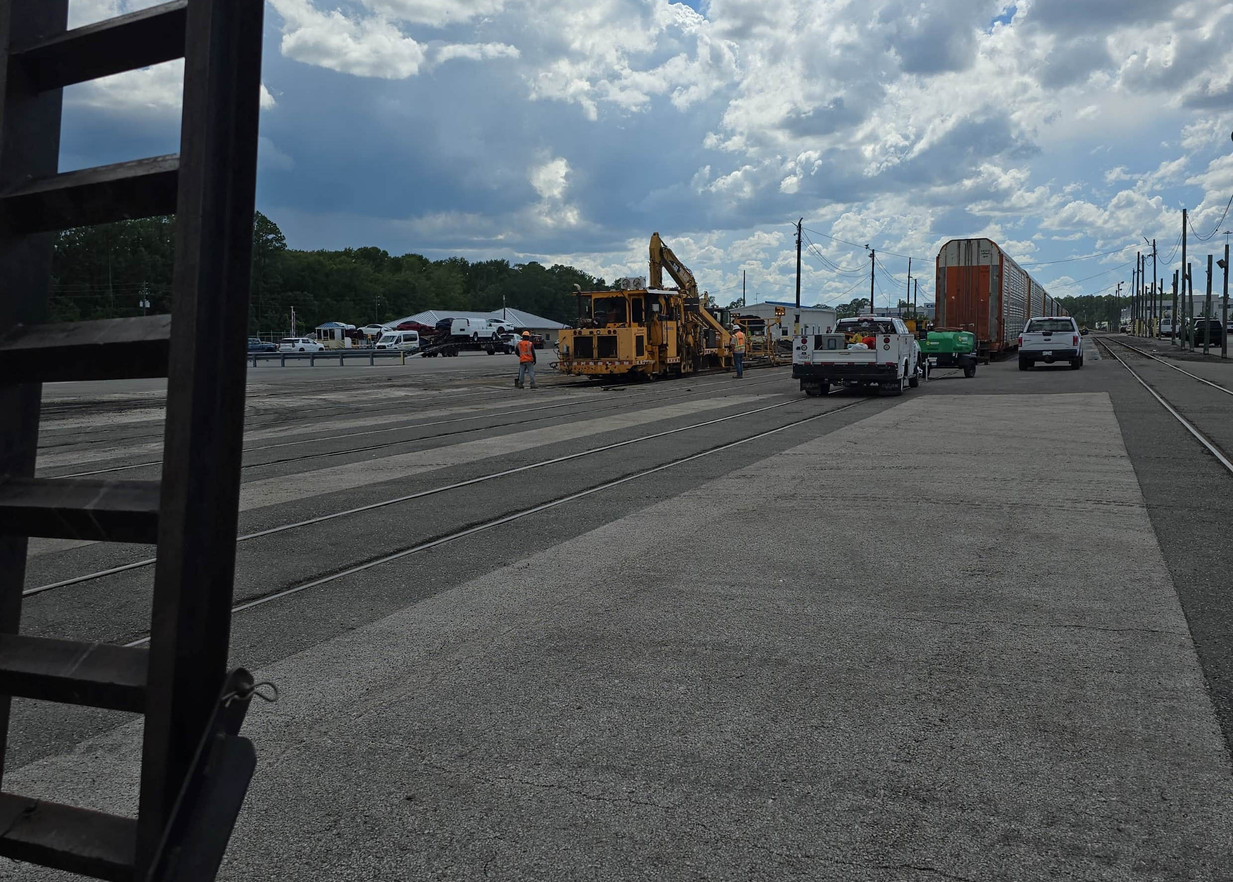
“ASPHALT REPAIRS CSX RAIL YARD”
JACKSONVILLE FLORIDA

Slide 31
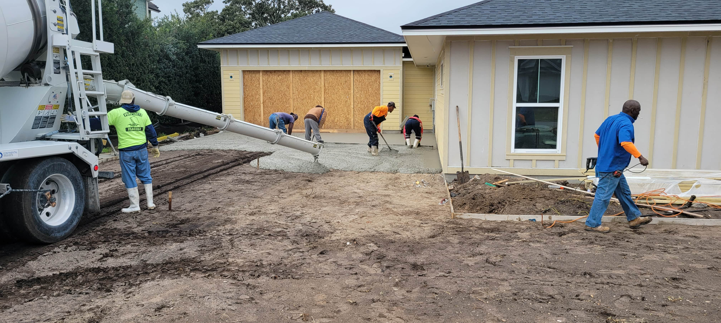
“PONTE VEDRA BEACH CIRCLE DRIVE”
JACKSONVILLE FLORIDA

Slide 32
“PONTE VEDRA BEACH CIRCLE DRIVE”
JACKSONVILLE FLORIDA

Slide 33
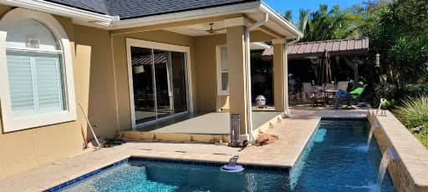
“REAR PORCH ELEVATE – JAX BEACH”
JACKSONVILLE FLORIDA

Slide 34
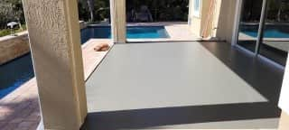
“REAR PORCH ELEVATE – JAX BEACH”
JACKSONVILLE FLORIDA

Slide 35
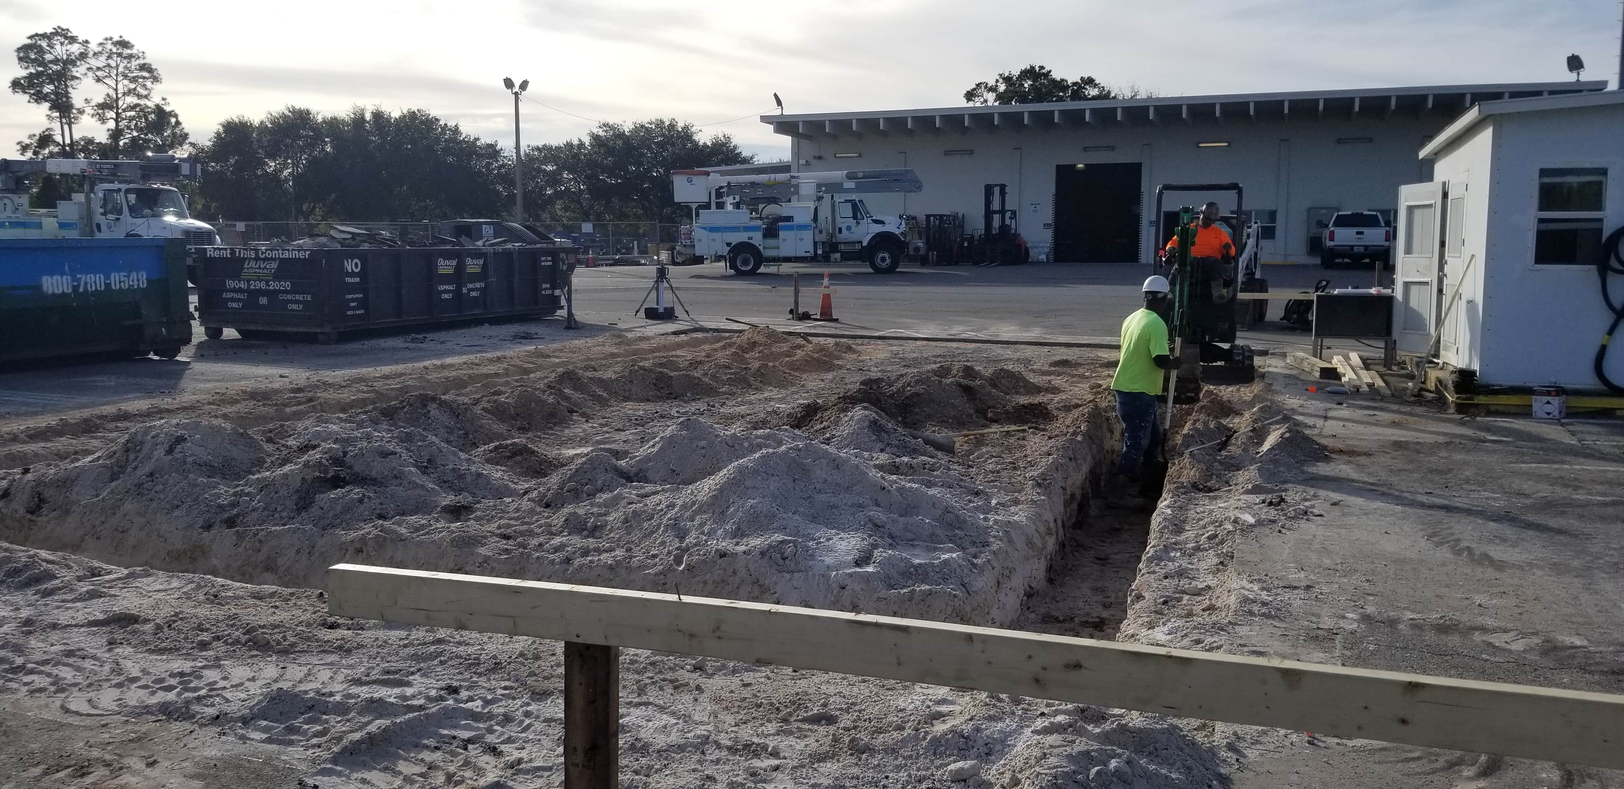
“FPL STORM SHELTER FOUNDATION”
ST. AUGUSTINE FLORIDA

Slide 36
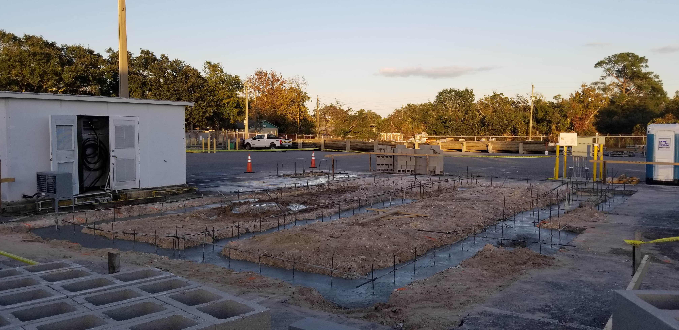
“FPL STORM SHELTER FOUNDATION”
ST. AUGUSTINE FLORIDA

Slide 37
“FPL STORM SHELTER FOUNDATION”
ST. AUGUSTINE FLORIDA

Slide 38
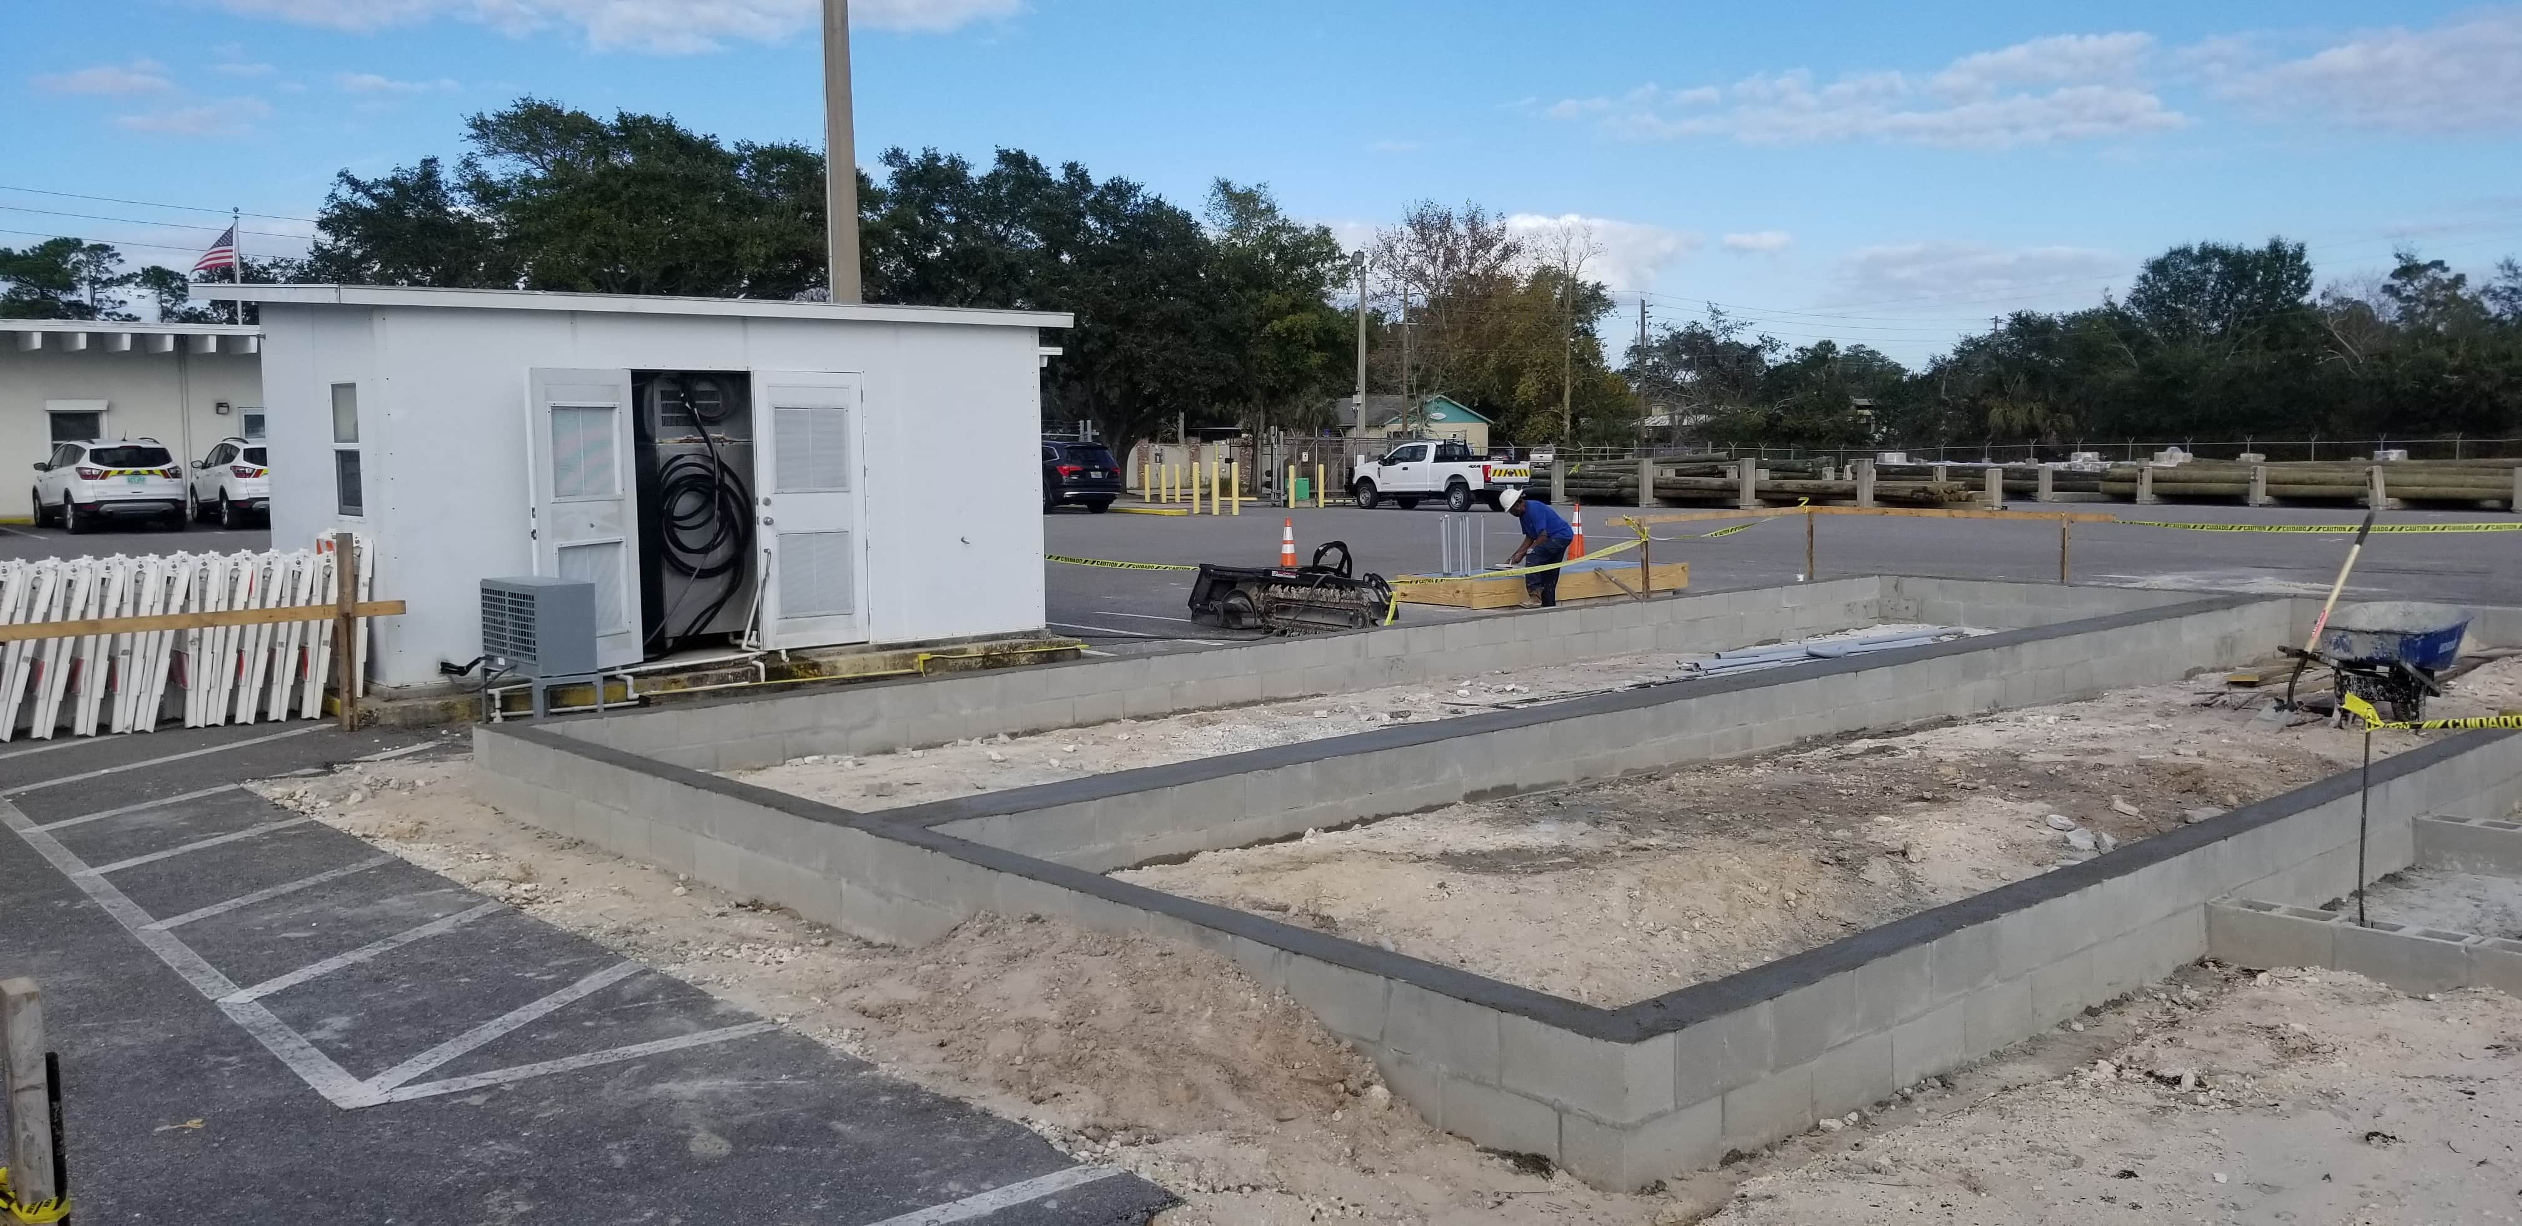
“FPL STORM SHELTER FOUNDATION”
ST. AUGUSTINE FLORIDA

Slide 39
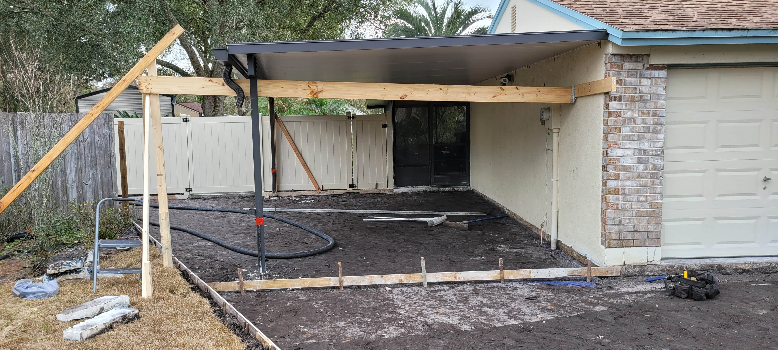
“CHALLENGE ACCEPTED – DRIVEWAY”
MIDDLEBURG FLORIDA

Slide 40
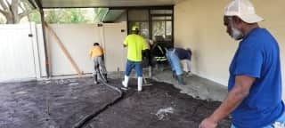
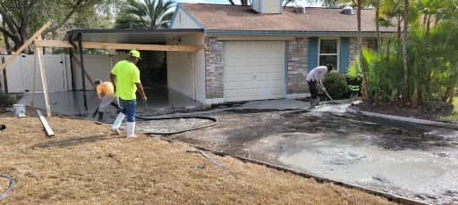
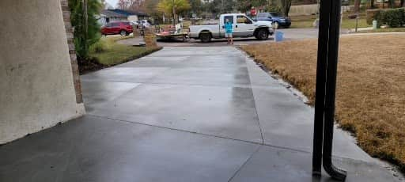
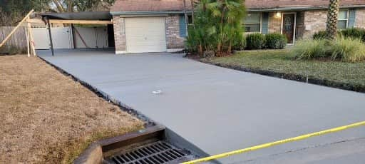
“CHALLENGE ACCEPTED – DRIVEWAY”
MIDDLEBURG FLORIDA

Slide 41
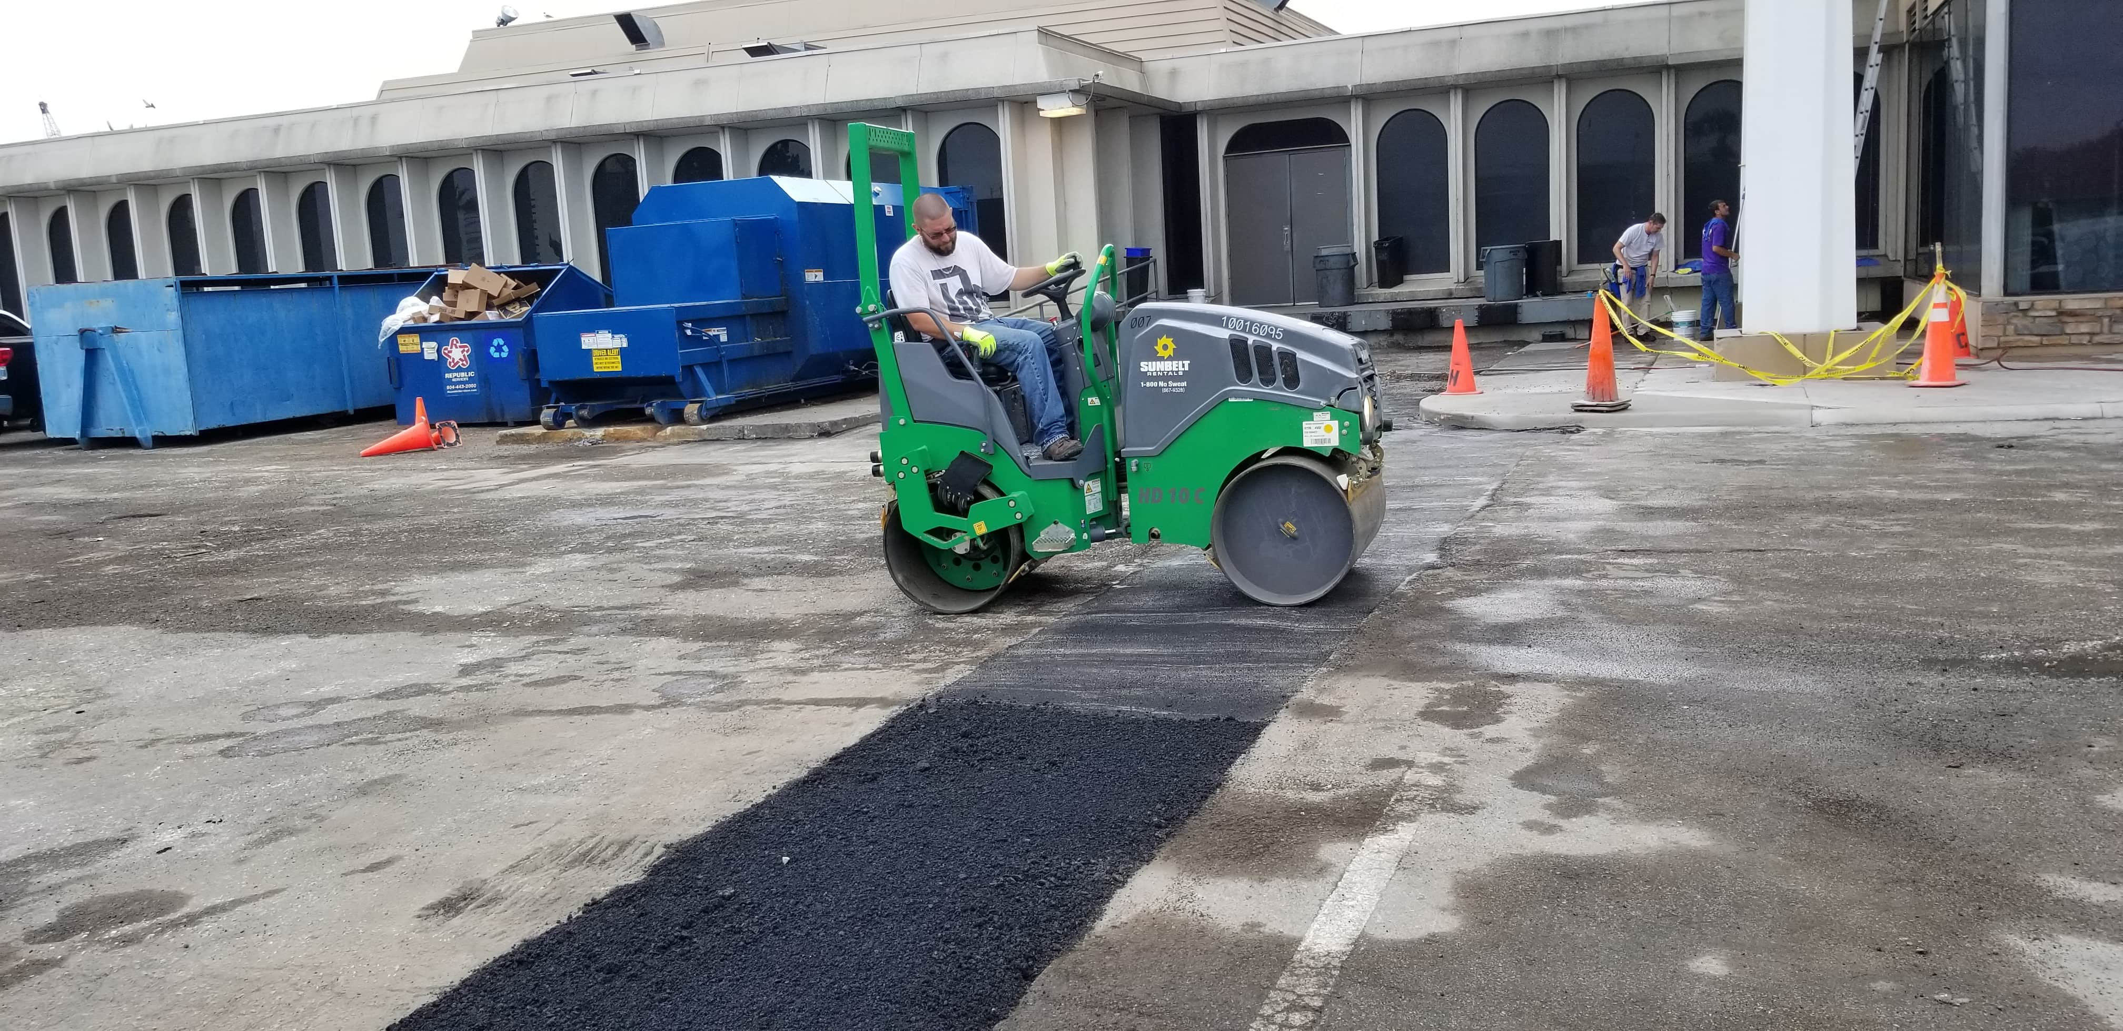
“RUTH’S CHRIS ASPHALT AND SIDEWALK REPAIRS”
JACKSONVILLE FLORIDA

Slide 42
“SIDEWALK & CURB REPAIRS”
MANDARIN / SAN MARCO - JAX FLORIDA

Slide 43
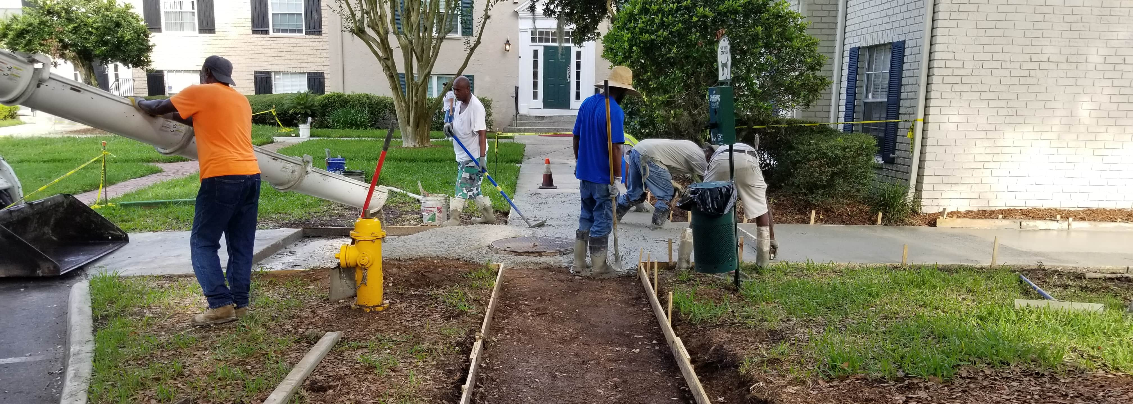
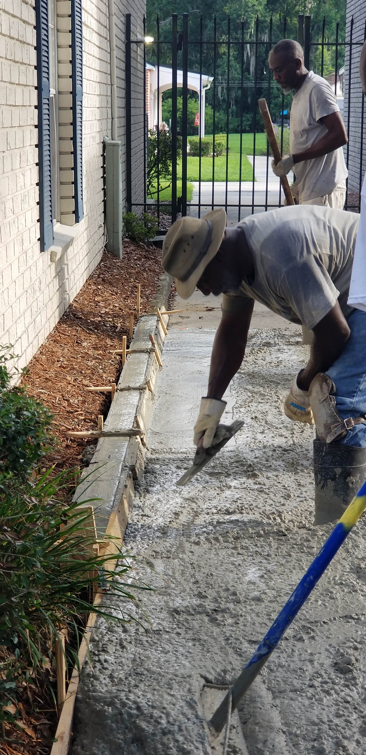
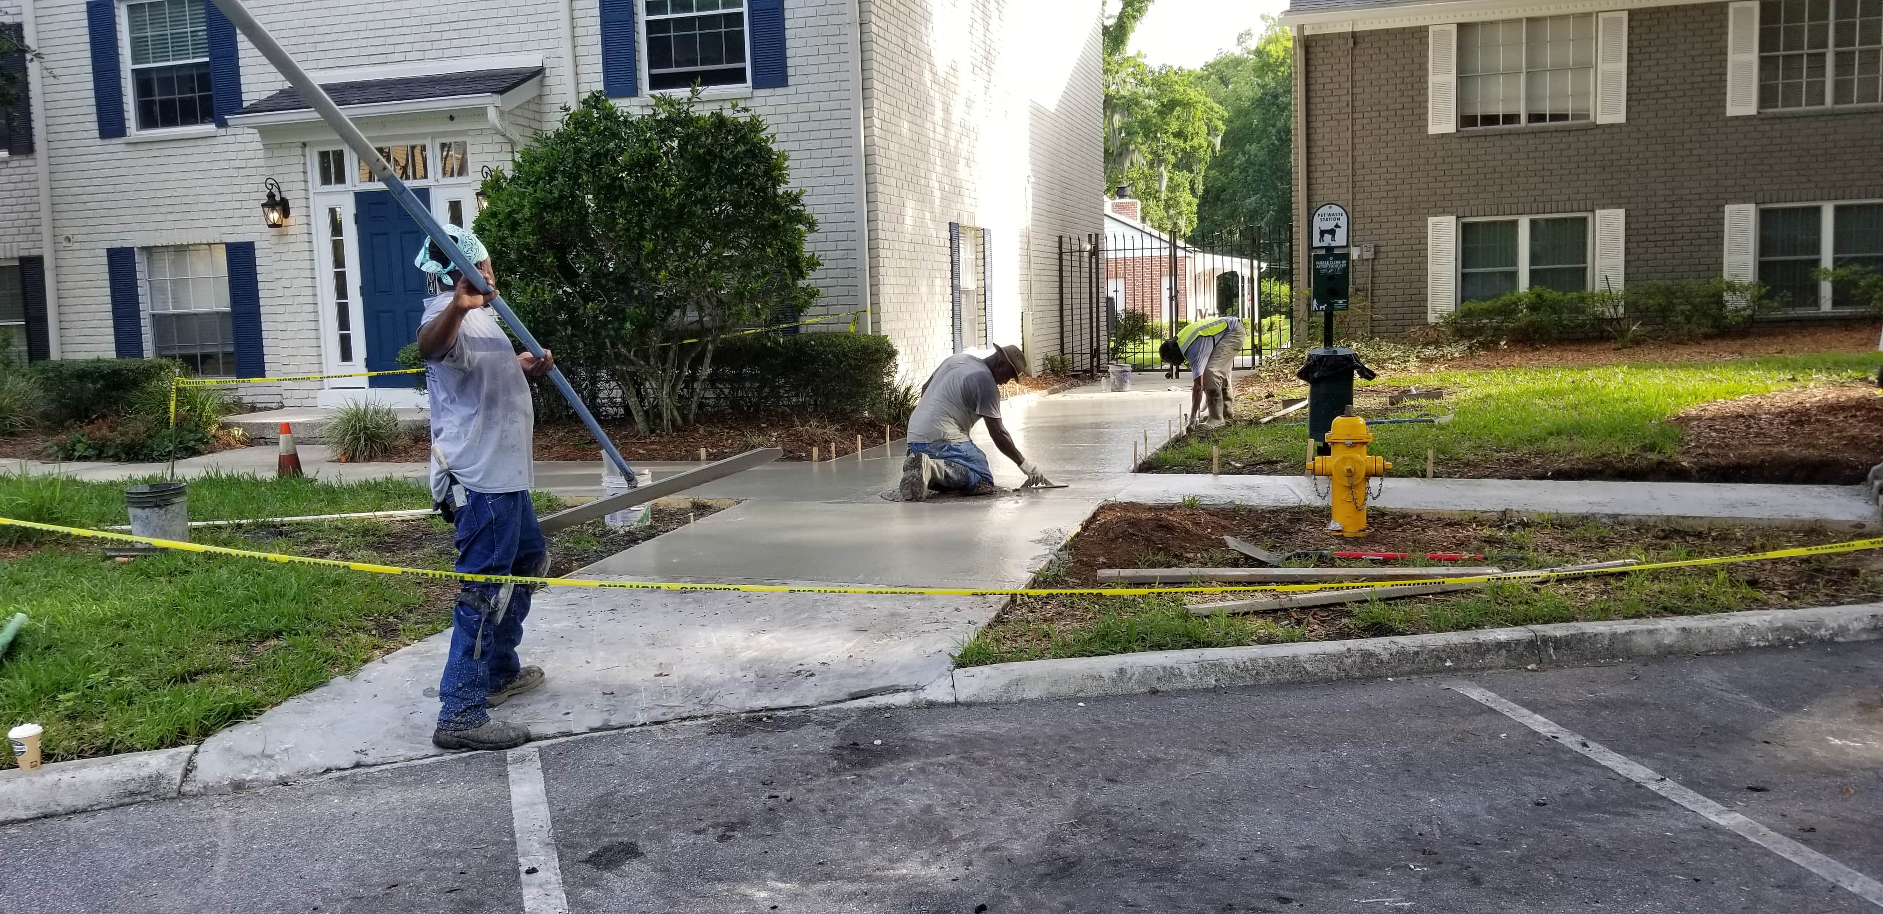
“SIDEWALK & CURB REPAIRS”
MANDARIN / SAN MARCO - JAX FLORIDA

Slide 44
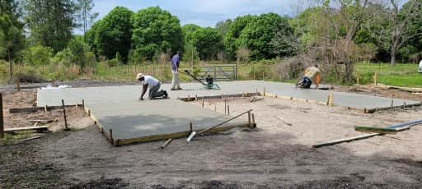
“GARAGE SLAB W APRONS”
CALLAHAN FLORIDA

